Slide 1
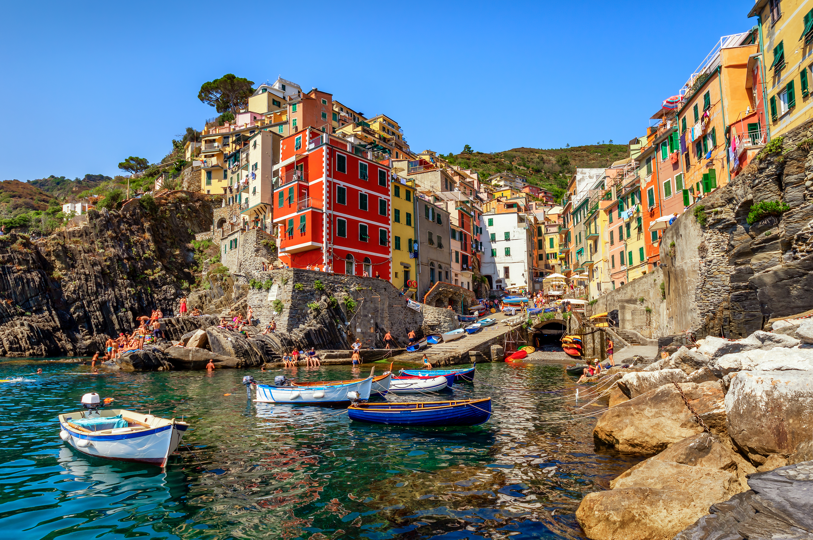
Evaluation of Coastal Erosion
Danielle Lamb
DSC680-T301

Slide 2
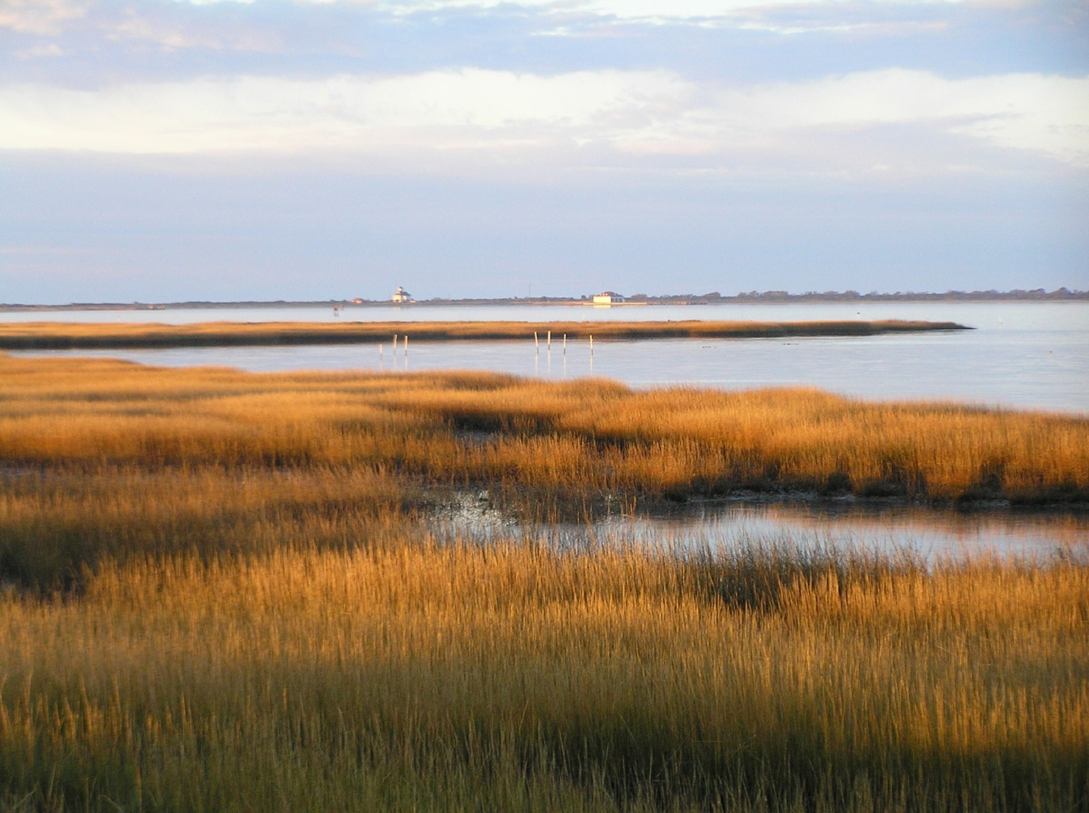
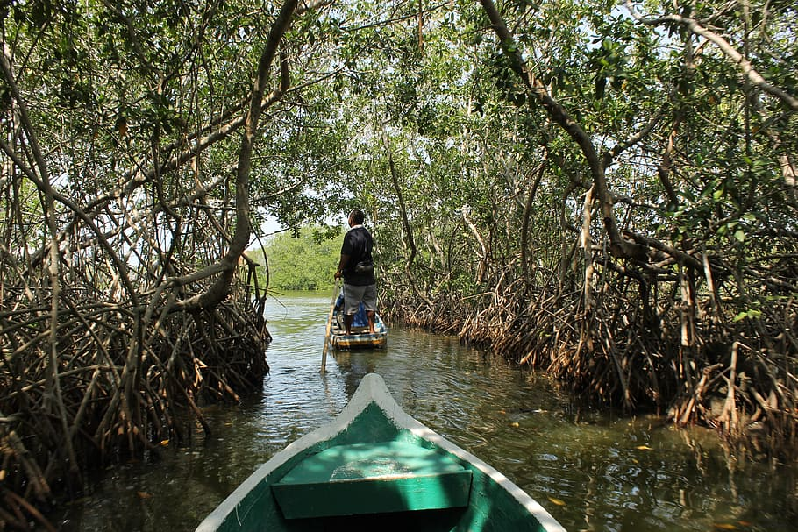

Natural Protections
The coastline is protected by numerous ecosystems. These ecosystems prevent sediment washout and flooding onto land
Marshes are large expanses that flood and dry with the tide. Numerous reed species and filter feeders lock in sediment and break wave action
Mangrove forests feature trees that have spindly roots that also lock in sediment to prevent loss in addition to absorbing waves and wind before making it to mainland

Slide 3
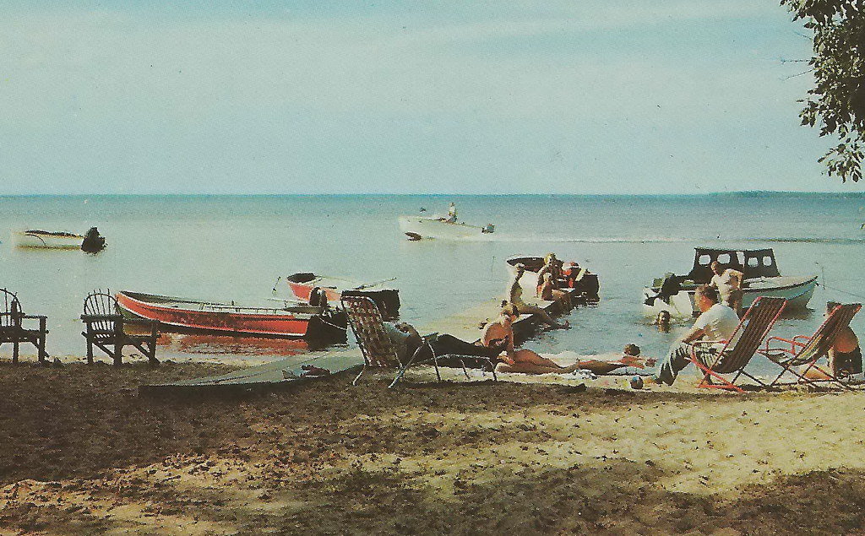
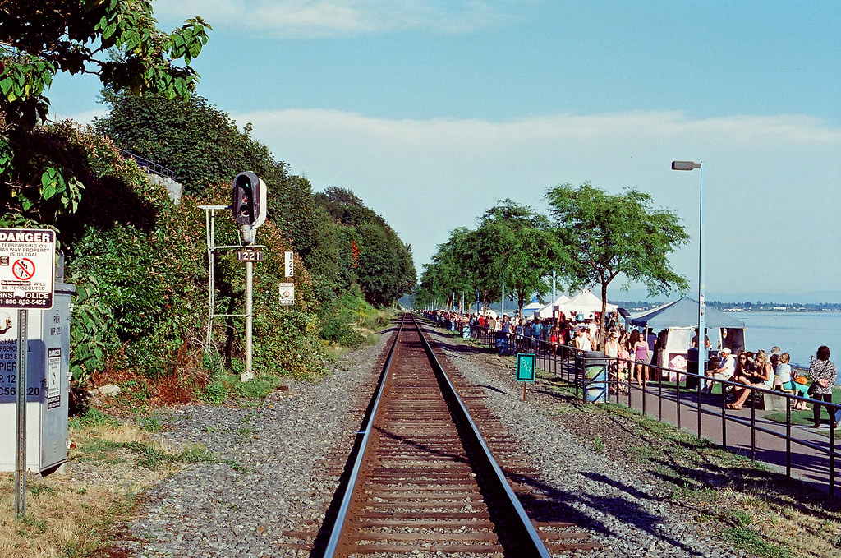
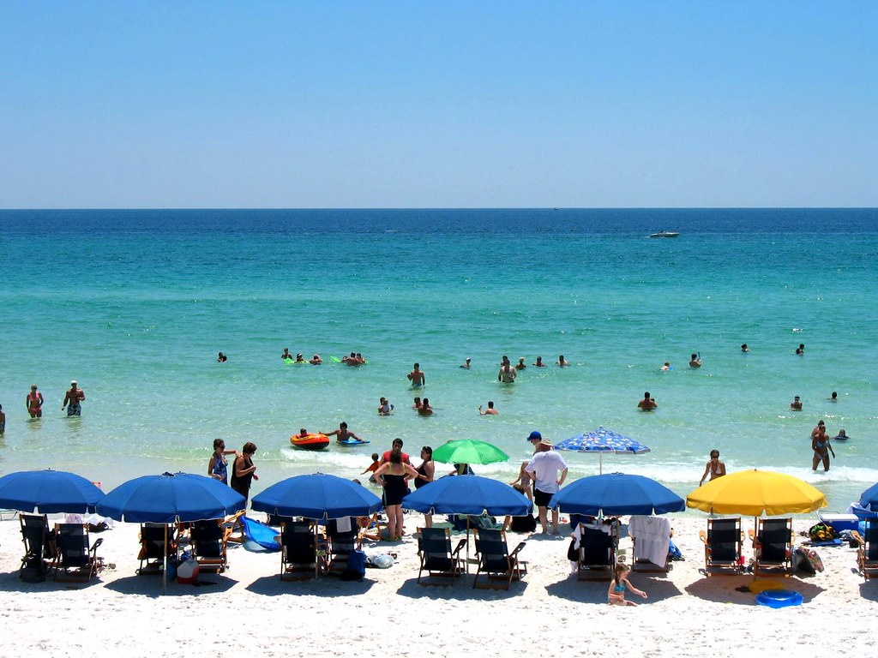
Tourism pandemic
Of the total amount of land in the contiguous United States, less than 10% are coastal areas
Beaches became a popular vacation spot beginning in the mid-19th century
Now, almost half of the United States population lives in a county lining the coastlines, totaling 127 million people
Coastal towns are the most susceptible to flooding and hurricanes, in addition to climate change and sea level rise
EVALUATING COASTAL EROSION
2022
Notes:
127 entire population of japan

Slide 4
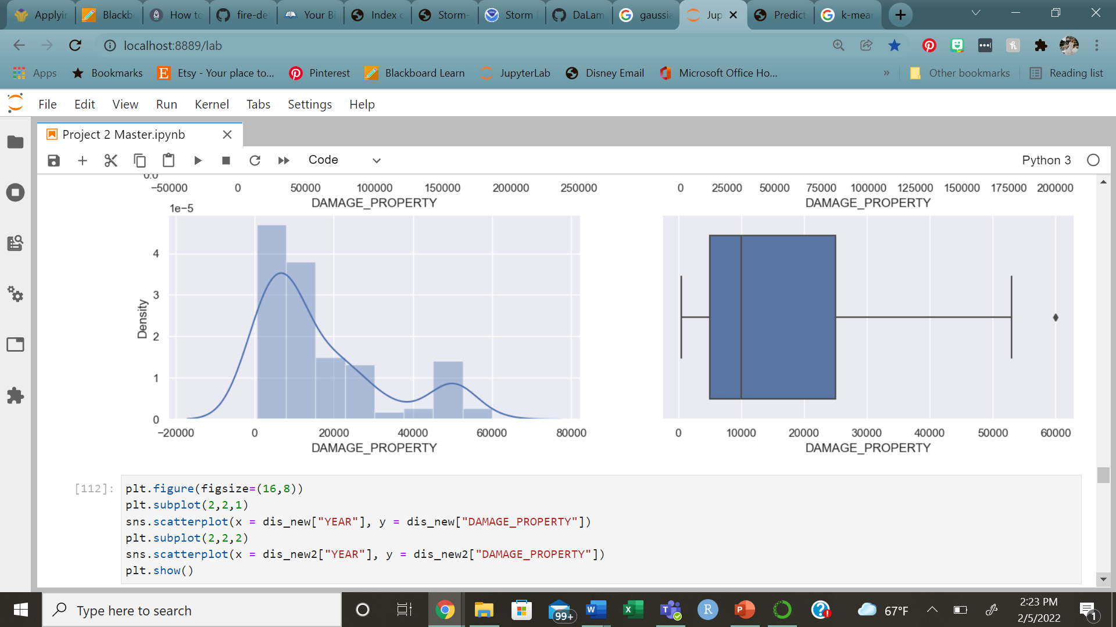
Damage Data
SUMMARY
After cleaned, the data was comprised of 153 observations over 10 years
With one larger peak and an additional smaller peak, k-means model would not be ideal
Gaussian Mixture Model fits data that have uneven clusters

Slide 5
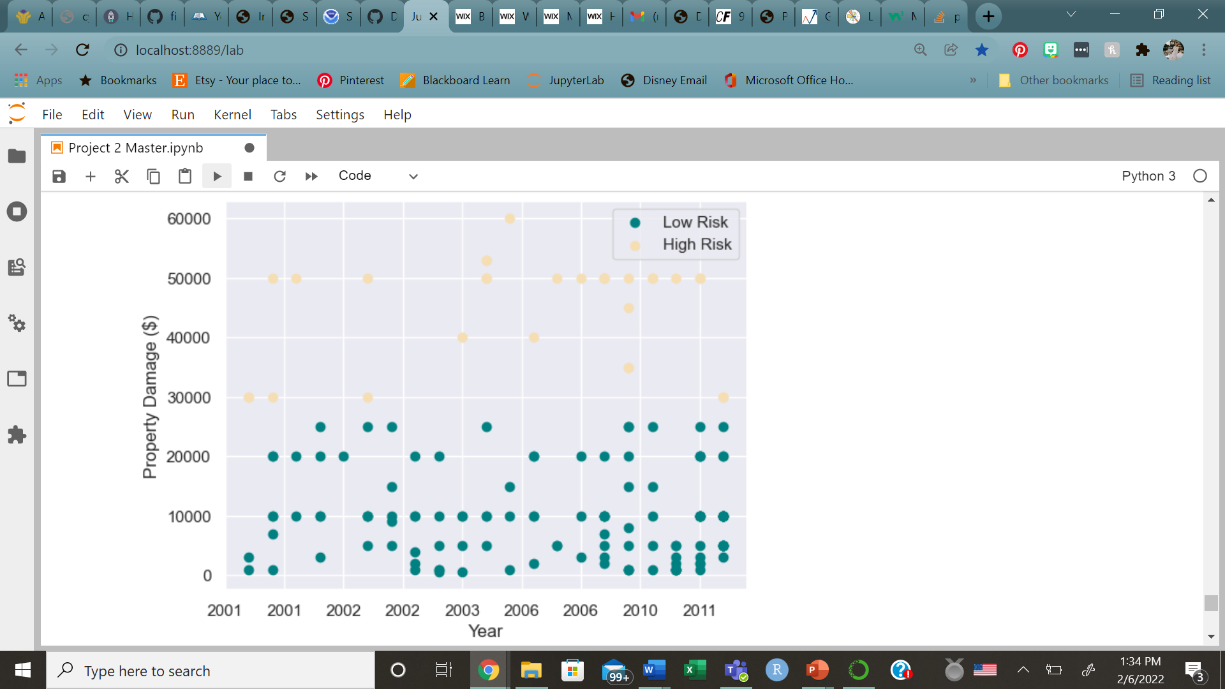
Gaussian Mixture Model
A majority of points were low on the y-axis
Those at or above $30,000 were grouped in a second cluster
No trend was found along the timeline

Slide 6
High Risk Results
The majority of observations within the high risk category were in New York.
Overall, most observations were because of flash flooding.
The threshold of low vs. high risk was determined to be $30,000. Values above this could be considered at high risk for storm damage
The range of high risk damage was from $30,000 to $53,000. However, outliers lying above these values were removed for modeling reasons yet still belong in the high risk category.
State | Number of High Risk Events | Most Popular Event Type | Average Event Damage
New York | 17 | Flash Flooding | $45,000
Mississippi | 4 | Flash Flooding | $52,500
Georgia | 2 | Flash Flooding | $40,000

Slide 7
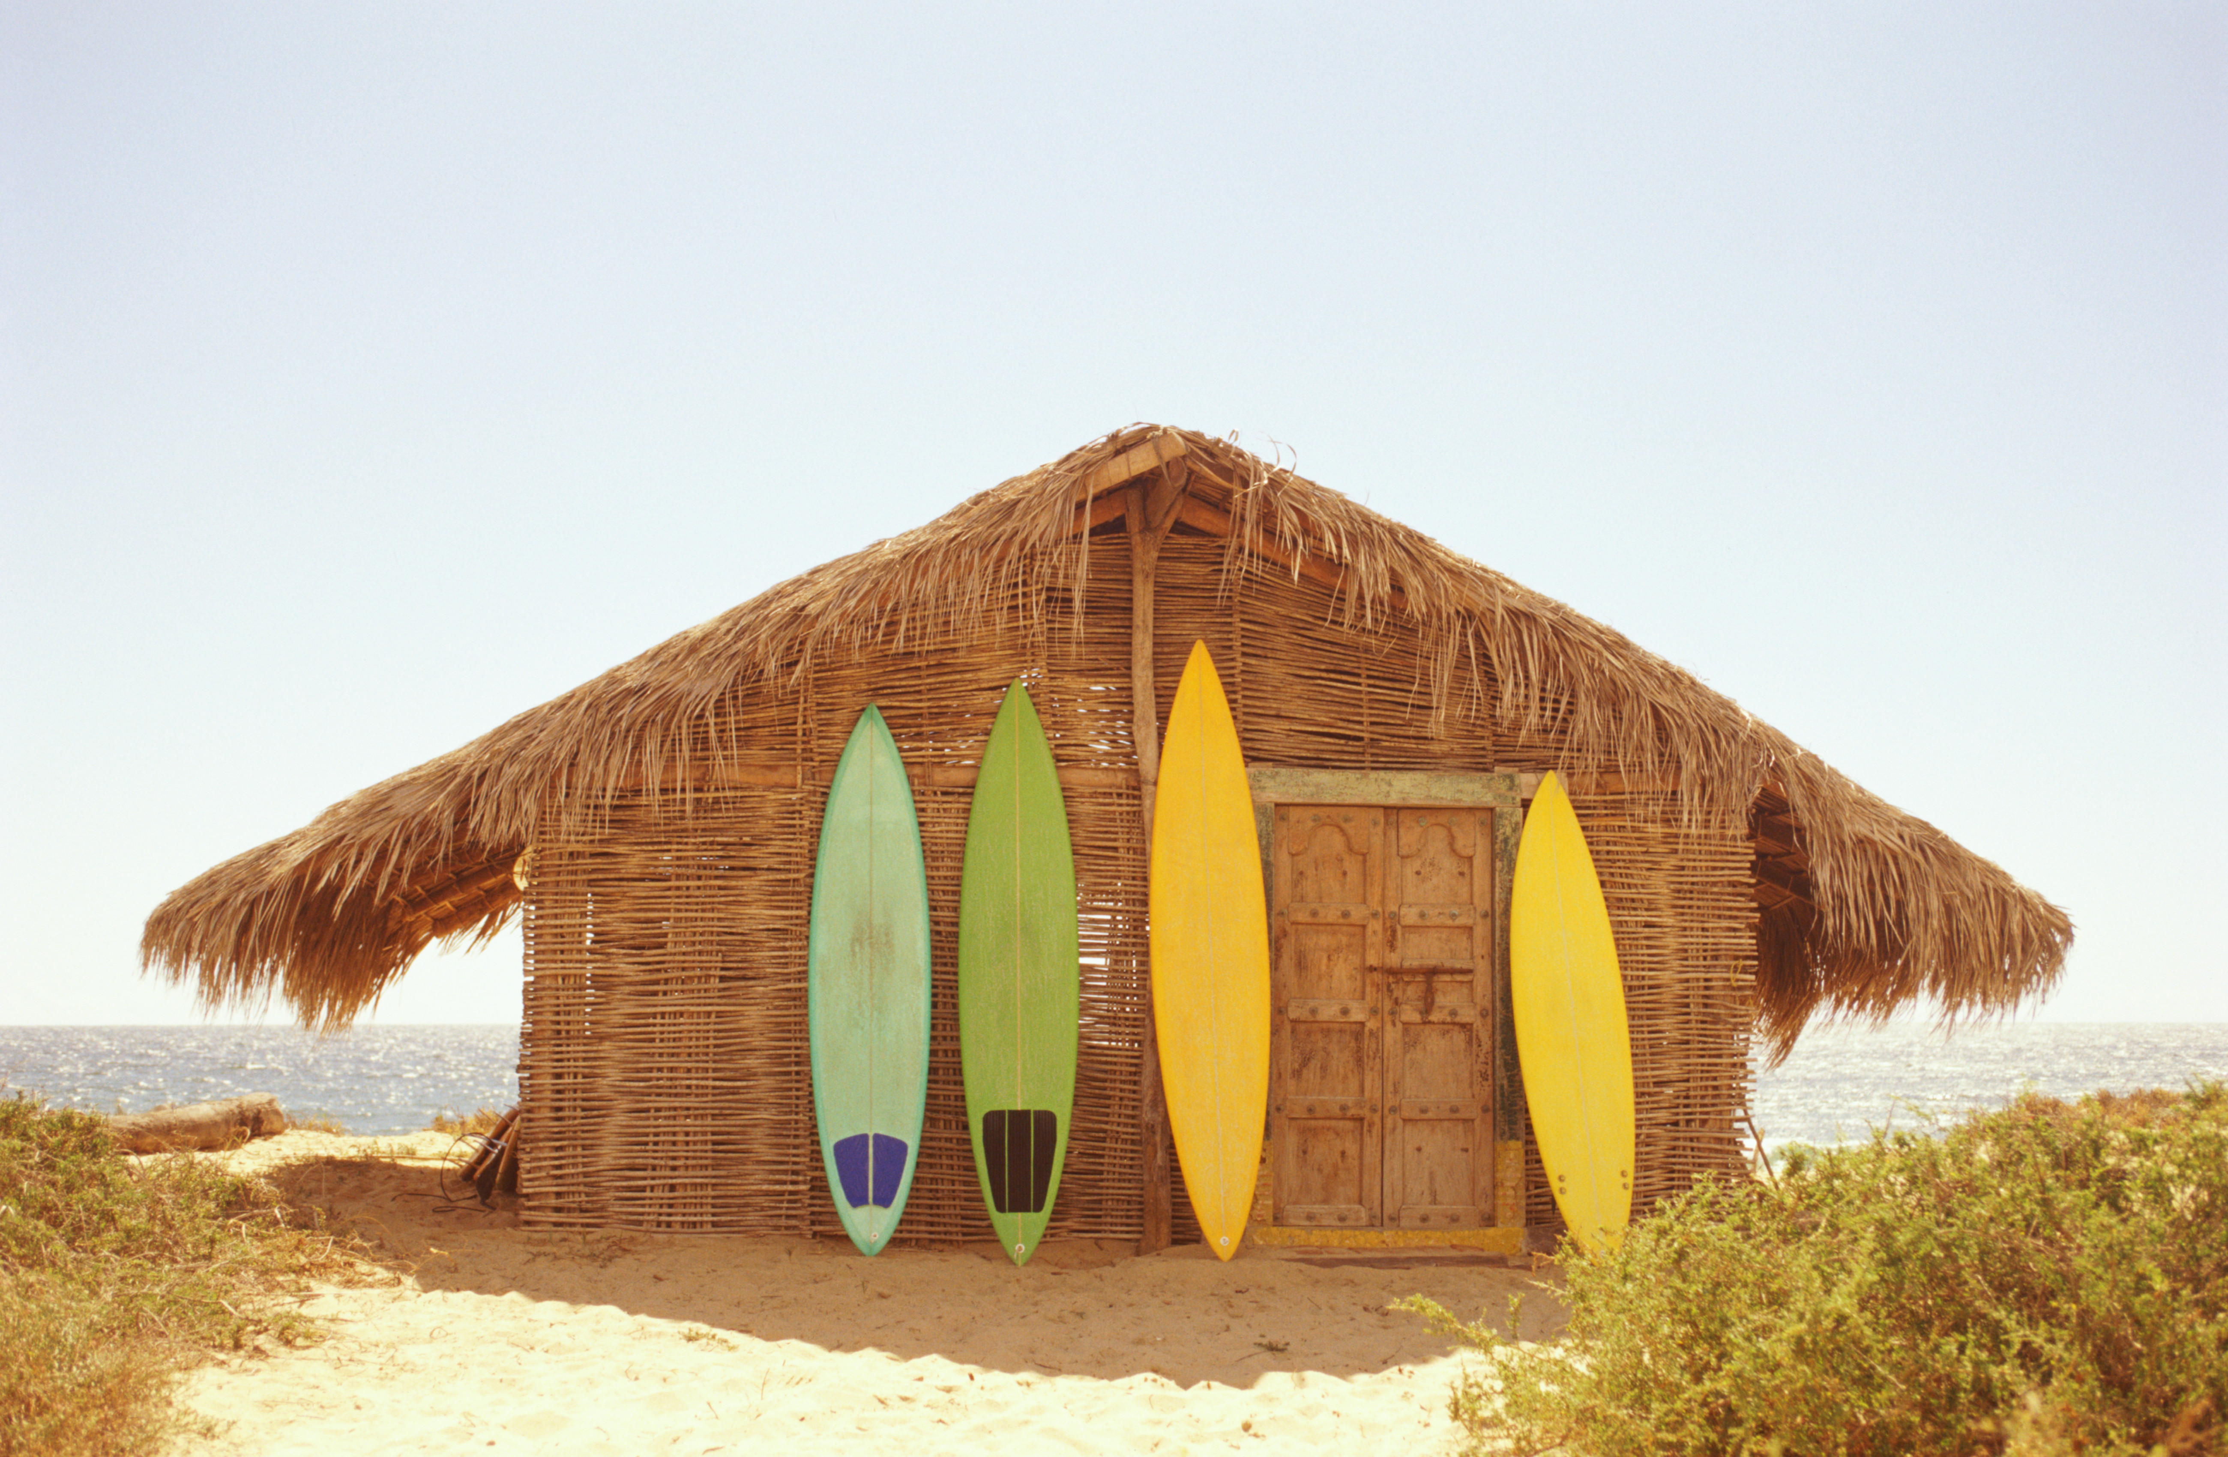

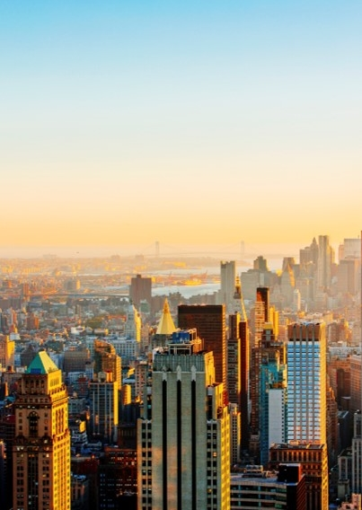
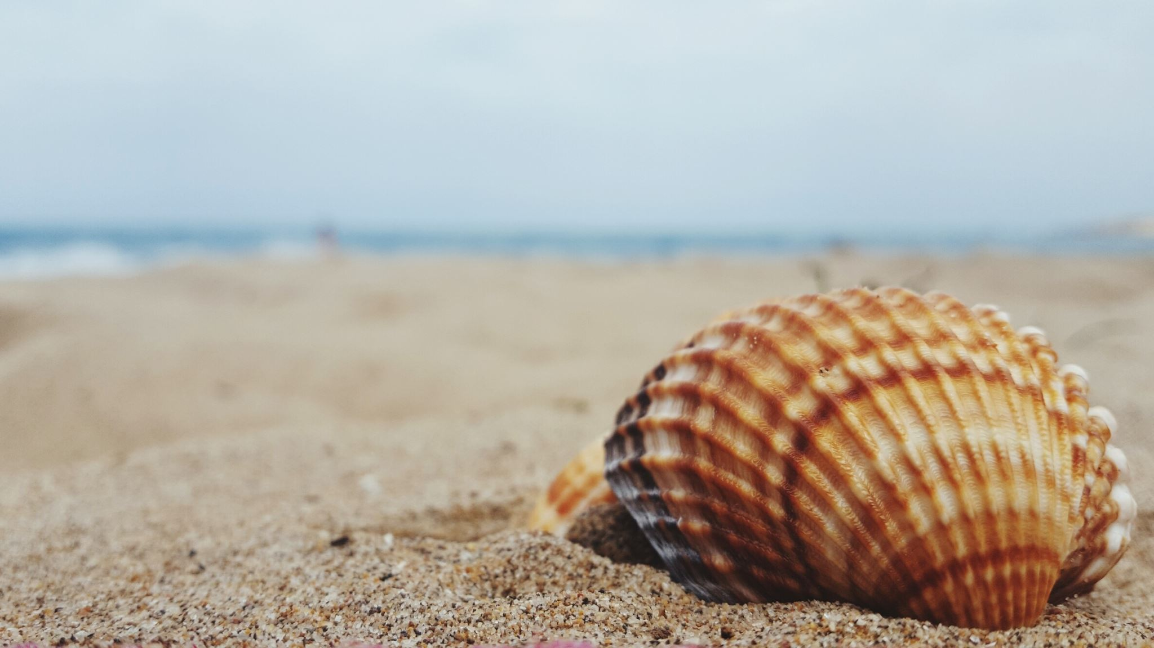
Summary
Coastlines are naturally protected by ecosystems such as coral reefs, mangrove forests, marshes, and mangrove forests. With the addition of cities and towns along the coast, these important ecosystems are quickly disappearing
As a result, more damage could happen in major weather events because of the lack of natural protection. If more towns made a larger effort to restore lost coastal wetlands and protect existing ones, there is the potential for less damage in severe weather.
Notes:
While beach towns and cities are a fun place to visit, there are risks that are taken if there is no consideration for the natural protective ecosystems along the coast. Strong storms and extreme weather events could cause flooding that is more damaging than if coastal wetlands were protected or restored. Existing towns with a high risk should consider restoring more natural protective ecosystems if they do not want further damaging events. In addition to storm protection, these ecosystems can bring further tourism and health to the surrounding area.

Slide 8
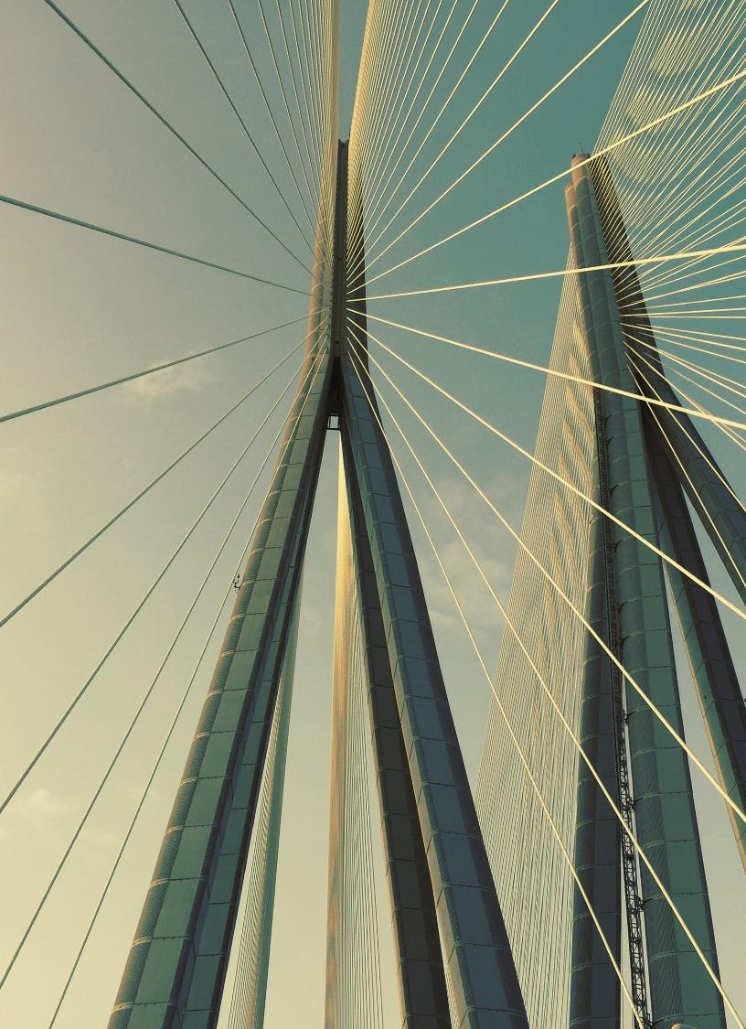
Thank you
Danielle Lamb
DanielleTLamb@gmail.com
https://datrep14.wixsite.com/datascientist

